Slide 1
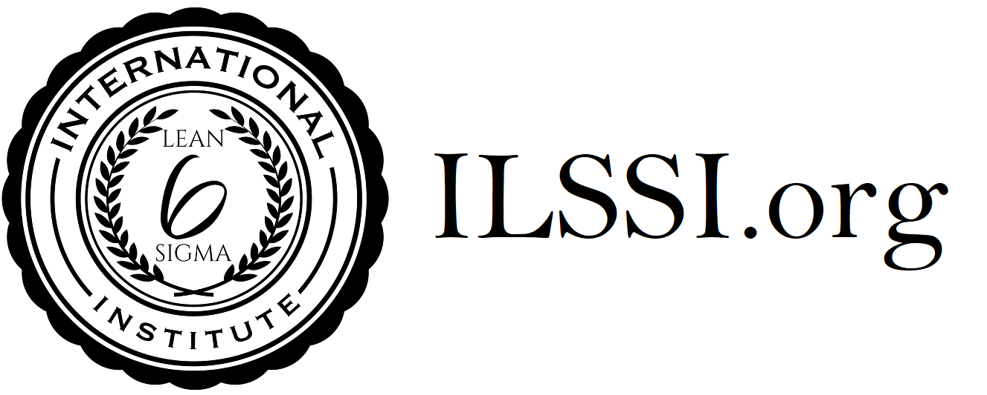
Version 3 : 2024
ILSSI Body of Knowledge for Lean Yellow Belt
Fundamentals of OPEX
General History of Lean
Principles of Lean
Voice of the Customer and Business
Lean Belt Roles
Defining a Process
The 8 Elements of Waste
Sustainability
5S
SIPOC
Process Mapping
Value Stream Mapping
Flow and Line Balancing
Single-Piece-Flow
Poka-Yoke (Mistake Proofing)
SMED (Quick Change Over)
PULL and Just-in-Time
Kanban
Visual Management
Standardised Work
Kaizen and Kaizen Events
PDCA
DMAIC basics
Root Cause Analysis
Cause & Effect / Fishbone Diagrams

