Slide 1
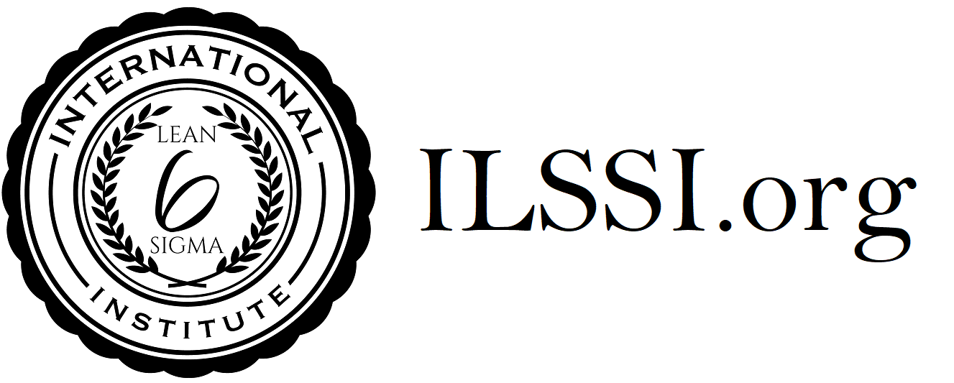
Version 6 : 2023
ILSSI Body of Knowledge for Lean Green Belt /Certified Lean Practitioner
Fundamentals of OPEX
General History of Lean
Principles of Lean
Voice of the Customer and Business
Lean Belt Roles
Defining a Process
The 8 Elements of Waste
Sustainability
5S
Defining Quality
Quality Circles
Critical to Quality (CTQs)
SIPOC
Process Mapping
Value Stream Mapping
Flow and Line Balancing
Little’s Law and Kingsman’s Law
TOC and Bottle-necks
Single-Piece-Flow
Poka-Yoke (Mistake Proofing)
SMED (Quick Change Over)
PULL and Just-in-Time
Kanban
Visual Management
Standardised Work
Kaizen and Kaizen Events
Fake Lean vs Real Lean
The Gemba and Gemba Walks
Lean Leadership Style
PDCA
DMAIC basics
Define Phase of DMAIC
Problem / Opportunity Definition
A3 Reports
Measure Phase of DMAIC
Data Collection
Graphical Analysis
Analyze Phase of DMAIC
Root Cause Analysis
Cause & Effect / Fishbone Diagrams
Improve Phase of DMAIC
Digital Transformation / Automation / Robotics as examples of Improvement
Control Phase of DMAIC

